Slide 1


答 辩
在这里添加你的文字，图片也可以。在这里可以添加文字内容。

Slide 2
壹
贰
叁
肆
目 錄
点击输入本栏的具体文字，简明扼要的说明分项内容，点击输入本栏的具体文字
选题的背景与意义
点击输入本栏的具体文字，简明扼要的说明分项内容，点击输入本栏的具体文字
研究方法及过程
点击输入本栏的具体文字，简明扼要的说明分项内容，点击输入本栏的具体文字
研究成果展示及应用
点击输入本栏的具体文字，简明扼要的说明分项内容，点击输入本栏的具体文字
论文总结

Slide 3
0 1
在这里添加你的文字，图片也可以。在这里可以添加文字内容。

Slide 4
请输入你的题目
请输入你的题目
请输入你的题目
请输入你的题目
Just for today I will try to live through this day only and not tackle my whole life problem at once. Just for today I will try to live through this day only and not tackle my whole life problem at once.
Just for today I will try to live through this day only and not tackle my whole life problem at once. Just for today I will try to live through this day only and not tackle my whole life problem at once.
Just for today I will try to live through this day only and not tackle my whole life problem at once. Just for today I will try to live through this day only and not tackle my whole life problem at once.
Just for today I will try to live through this day only and not tackle my whole life problem at once. Just for today I will try to live through this day only and not tackle my whole life problem at once.

Slide 5
ADD YOUR TITTLE
ADD YOUR TITTLE
Just for today I will exercise my soul in three ways. I will do somebody a good turn
Just for today I will exercise my soul in three ways. I will do somebody a good turn
ADD YOUR TITTLE
ADD YOUR TITTLE
Just for today I will exercise my soul in three ways. I will do somebody a good turn
Just for today I will exercise my soul in three ways. I will do somebody a good turn

Slide 6

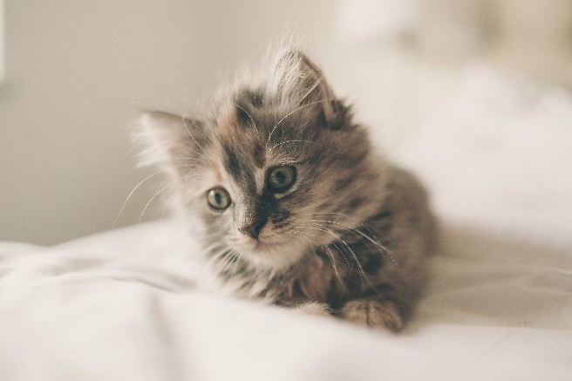

点 击 添 加 标 题
点 击 添 加 标 题
点 击 添 加 标 题
Just for today I will try to live through this day only and not tackle my whole life
Just for today I will try to live through this day only and not tackle my whole life
Just for today I will try to live through this day only and not tackle my whole life

Slide 7
0 2
在这里添加你的文字，图片也可以。在这里可以添加文字内容。

Slide 8

hours that Just for today I will try to live through this day only and not tackle my whole life problem at once. I can do for twelve hours that not tackle my
hours that Just for today I will try to live through this day only and not tackle my whole life problem at once. I can do for twelve hours that not tackle my
TITTLE HERE
hours that Just for today I will try to live through this day only and not tackle my whole life problem at once. I can do for twelve hours that not tackle my
Just for today I will try to live through this day only and not tackle my whole life problem at once. I can do for twelve

Slide 9
ADD YOUR TITTLE
Just for today I will try to live this day only and not tackle my whole life problem at
ADD YOUR TITTLE
Just for today I will try to live this day only and not tackle my whole life problem at
ADD YOUR TITTLE
Just for today I will try to live this day only and not tackle my whole life problem at
ADD YOUR TITTLE
Just for today I will try to live this day only and not tackle my whole life problem at

Slide 10

ADD YOUR TITTLE HERE
Just for today I will try to live this day only and not tackle my whole life problem at Just for today I will try to live this day only and not tackle my whole life problem at
ADD YOUR TITTLE
Just for today I will try to live this day only and not tackle my whole life problem at
ADD YOUR TITTLE
Just for today I will try to live this day only and not tackle my whole life problem at
ADD YOUR TITTLE
Just for today I will try to live this day only and not tackle my whole life problem at

Slide 11
0 3
在这里添加你的文字，图片也可以。在这里可以添加文字内容。

Slide 12
01
02
03
04
YOUR TITLE
YOUR TITLE
YOUR TITLE
YOUR TITLE
three ways. I will do somebody a good turnJust for today I will try to live through this day only and
three ways. I will do somebody a good turnJust for today I will try to live through this day only and
three ways. I will do somebody a good turnJust for today I will try to live through this day only and
three ways. I will do somebody a good turnJust for today I will try to live through this day only and

Slide 13
0 4
在这里添加你的文字，图片也可以。在这里可以添加文字内容。

Slide 14
Just for today I will try to live through this day only and not tackle my whole life once.
Just for today I will try to live through this day only and not tackle my whole life once.
+
-
TEXT HERE
CONTENTS
+
-
Just for today I will try to live through this day only and not tackle my whole life once.
Just for today I will try to live through this day only and not tackle my whole life once.

Slide 15
谢 谢
在这里添加你的文字，图片也可以。在这里可以添加文字内容。

